Slide 1
Requirement Elicitation: Toward the Unknown Unknowns
Alistair Sutcliffe and Pete Sawyer
University of Lancaster
School of Computing and Communications
Presented by Pavneet Kaur Mukar

Slide 2
Key Contributions of the Paper
Requirement elicitation from perspective of Common Ground and requirement specification framework
Propose a roadmap to tackle elicitation problems involving tacit knowledge
Remarks the possibility of tackling “Unknown unknown requirements”
Open research prospects for techniques, models and tools in green field domain[few solutions already exist] and brown field domains [collections of requirements and products exist]

Slide 3
What is Requirement Elicitation?
Elicitation technique covers identification of stakeholders, fact gathering, collecting requirements in different forms, prioritizing and finally recording them.
Issues with RE:
Missing or mistaken requirements delay projects time
Increased cost over-runs

Slide 4
Approach for discussion
Elicitation Review Framework : elaboration of unknown definitions
Analyzing of different elicitation techniques and tools using ERF
Road map for future requirement elicitation research using ERF in context of green field and brown field RE

Slide 5
Elicitation Review Framework [1/4]
Used to elucidate properties of elicitation techniques rather than to score them for effectiveness or appropriateness since the objective is to investigate how different aspects of requirements elicitation contribute to requirement understanding.
Second part uses the “Clark’s theory of Common Ground”, to evaluate elicitation techniques and representations in terms of human conversations.

Slide 6
Elicitation Review Framework [2/4]
The requirements can be divided in the following format:
Known knowns: it is known to the stakeholder and analyst
Known unknowns: analyst is aware of type of knowledge but the customer might have forgotten to inform it
Unknown knowns: knowledge held by stakeholder but is not articulated due to issues
Unknown unknowns: most severe threat posing, when best domain knowledge is unknown i.e. both party unaware of missing or relevant knowledge

Slide 7
Elicitation Review Framework [3/4]
Tacit knowledge framework is divided using properties :
Properties | Known knowns | Known unknowns | Unknown knowns | Unknown unknowns
Expressible [known knowledge] | YES | NO | YES | NO
Articulated [documented known knowledge] | YES | NO | NO | YES
Relevant [to project] | YES | POTENTIALLY | YES | POTENTIALLY

Slide 8
Elicitation Review Framework [4/4]
Tacit knowledge poses the following threats:
Identifying tacit knowledge : even when the analyst suspects they exist.
Knowing what is relevant and what should be articulated, necessary details issue
Articulating the knowledge where it is needed, i.e. in correct context
Solution: recognize there may be missing info and prepare to invest resources in finding out if there is any

Slide 9
Requirement Elicitation Technique[1/3]
Basic elicitation techniques are:
Interviews
Observations
Workshops
Protocols
Scenarios
Prototypes etc
But a combination of these techniques is used to find out the unknown requirement
Ex: Scenario+ Prototype= helps in design improvement

Slide 10
Requirement Elicitation Technique[2/3]
UNKNOWN DISCOVERY:
The ability to detect unknown depends on analyst’s plan and sampling strategy
Technique | Unknown unknown methods
Interview | Flexible, follow-up questions etc
Observations | Using ethnography provide memory prompts
Workshops | Number and composition
Protocol | Least effective as more resource intensive
Scenario | Sample size , diversity , economic to collect
Prototype | Least effective , articulation limited

Slide 11
Requirement Elicitation Technique[3/3]
B. ESTABLISHING COMMON GROUND THROUGH ERF
Common ground explains how a meaning is constructed by conversation and action between the stakeholder and analyst.
Technique | Reflection | Scope/Arena
Interviews | Only via notes/recording | Good but depends on participant and time
Workshops | Only via notes | Depends on sample and time of participant
Scenario | Good | Depends on sample data
Prototype | Good but depends on extent | Limited to ecological evaluation
Interview + workshops are more effective for tacit knowledge.
Scenarios provide grounding examples
Prototypes establish CG in the design , etc

Slide 12
Models[1/3]
Passive representations designed for inspection-based analysis or formal models which are integrated with model checking and reasoning tools
Depicts how they address different types of requirement knowledge
Different types of models are as follows:
Use Cases
Volere template
KAOS
GORE [Goal oriented requirement engineering]
i*
ISRE

Slide 13
Models(2/3)
Model | Specification | Domain Knowledge
Use Cases | Implicit goals | Limited
GORE | Goals in hierarchy form, gives details of the agents, objects ,processes etc | Detailed
KAOS | Refines requirement spec. Formal language is used | Represented in form of obstacles and assumptions
I* | Rich in representation, inter agent relationships are modelled as dependencies | Implicit
ISRE | Focuses on organizing and generating scenarios | Description of spatial env , ecological context of system

Slide 14
Models(3/3)
In spite of plethora of models , scenarios and volere template are more preferred, use cases are not suited for complicated / complex knowledge
The power of representations and models for discovering unknown depends on scope of their semantics and how the problem space is covered
But larger arena and setting in the CG are more comprehensive and thus much more difficult to understand
In CG perspective the role of models depends on how well the integration is done into the analyst-stakeholder dialogue using different process like walkthroughs or so

Slide 15
Tools Support[1/4]
Divided into 3 parts:
Natural Language tools: process requirement text and documents
Model- checking tools: Checkers and reasoners
Social Collaboration Support Tools: general support tools

Slide 16
Tools Support[2/4]
NATURAL LANGUAGE TOOLS
Ontologies: They are used to support inspection based elicitation and refinement which have been developed to support web services. They have simple model checking for consistency, detection of conflicts etc. It is useful for helping in the analyst’s understanding of the domain.
Text-mining tools: They help in categorizing of the requirement sets, and prioritization by grouping them according to the ownership and the similarity basis. More suited for brown field RE
Have potential for development to address the known unknowns

Slide 17
Tools Support[3/4]
MODEL CHECKING TOOLS
Model checker have been developed to determine the match between requirements for monitoring and environmental events and suggests how adaptations can be matched to information and its source in the environment
Rely on semi-formal interface i.e. conversion to more friendly language
Only address to known unknowns
To capture the unknown unknowns , support tools can be used like i-require, which allows users to record the requirement notes on the move

Slide 18
Tools Support[4/4]
SOCIAL COLLABORATION SUPPORT TOOLS
Harness human collective effort rather than relying on models/existing documents
Stimulates awareness of knowns from both the RE and user perspective by information sharing
Extend CG to multi party conversations by social networks
Capture and integrate the opinions of many over time
Once the requirements have been gathered, they are prioritized and agreement is made

Slide 19
STATE OF ART AND RESEARCH ROAD MAP[1/3]
Prospects of improvement
Clark’s Common Ground Theory emphasis on the process of building mutual understanding in the elicitation problems. It can be applied to understand the dependency between software machines and their environment.
Remote elicitation techniques will become more prominent once the applications become global and web oriented
Focusing on people-oriented issues may help to elicit the knowledge category of unknown knowns when people suppress details due to political issues or due to any other clashes

Slide 20
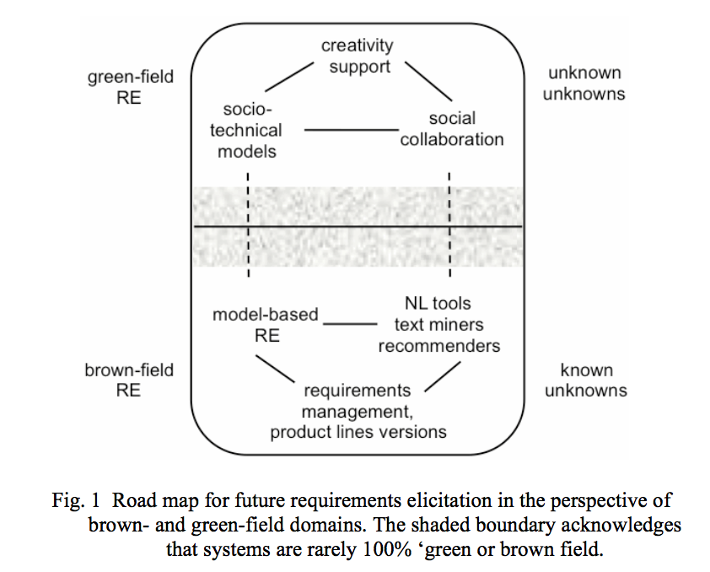
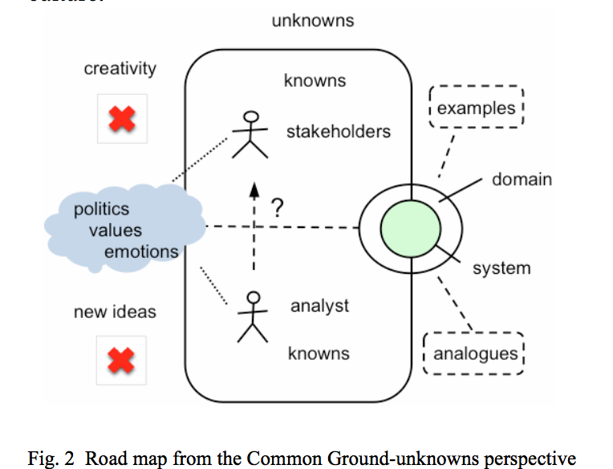
STATE OF ART AND RESEARCH ROAD MAP[2/3]

Slide 21
STATE OF ART AND RESEARCH ROAD MAP[3/3]
There are 4 research directions to push the boundaries of the unknowns:
Unknown knowns: Analyst discovers what the stakeholder knows but is not articulating, emotional intelligence guidance needs to be provided so that tacit knowledge is gathered
Known unknowns: Analyst has awareness of basic knowledge. Examples and analogies need to be extended so obstacles can be recognized.
Design discovery: Challenge is to solve “ I’ll know what I want when I see it” . Prototypes, storyboards and mockups have helped in overcoming this issue
Unknown unknowns: 2 approaches; Creative RE needs to inculcate the social media so that a collaborative data is formed. Use of analogies and examples can challenge the boundaries to develop new ideas

Slide 22
Conclusions
The elicitation of unknown unknowns can be considered through sophisticated tools, natural language approaches and social media inculcation.
While there is no ultimate solution to the unknown unknown problem beyond harness of human imagination, the quest for the issue is driven by life critical requirements
Embedding with different aspects of life like psychology, sociology etc can improve in gathering the requirement

Slide 23
Strengths of the Paper
Simple to understand
Various different requirement techniques and tools have been mentioned
Roadmap as to how to proceed with the data is mentioned

Slide 24
Weaknesses of the Paper
Main implementation towards the unknown unknowns is missing
No specific examples are mentioned for better understanding
No discussion of drawbacks, limitations is imposed for the unknown techniques

Slide 25
Open Questions and Future Research
Is there a better approach to address the unknown unknowns?
If the data is known to stakeholder but is not providing, what better techniques can be taken in consideration so that the complete information is articulated?
How to proceed once the unknown data has been captured towards the end of the system building?

